Slide 1
Schema Design
Lecture# 3

Slide 2
Weak Entity
In a relational database, a weak entity is an entity that cannot be uniquely identified by its attributes alone; therefore, it must use a foreign key in conjunction with its attributes to create a primary key The foreign key is typically a primary key of an entity it is related to.
In entity relationship diagrams a weak entity set is indicated by a bold (or double-lined) rectangle (the entity) connected by a bold (or double-lined) type arrow to a bold (or double-lined) diamond (the relationship). This type of relationship is called an identifying relationship

Slide 3
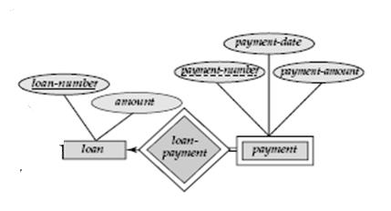
Examples

Slide 4
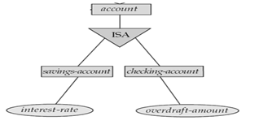
Specialization or Generalization
An entity set may include sub groupings of entities that are distinct in some way from other entities in the set. The process of sub grouping within an entity is called specialization or generalization.
Example:
The bank offers two types of accounts—savings and checking accounts.

Slide 5
Keys
A key allows us to identify a set of attributes that suffice to distinguish entities from each other. Keys also help uniquely identify relationships, and thus distinguish relationships from each other.
Primary key: A relational table uniquely identifies each record in the table.
Candidate key: A candidate key is a combination of attributes that can be uniquely used to identify a database record without any extraneous data. Each table may have one or more candidate keys. One of these candidate keys is selected as the table primary key.
Foreign key: keys are utilized to cross-reference data between relational tables.

Slide 6
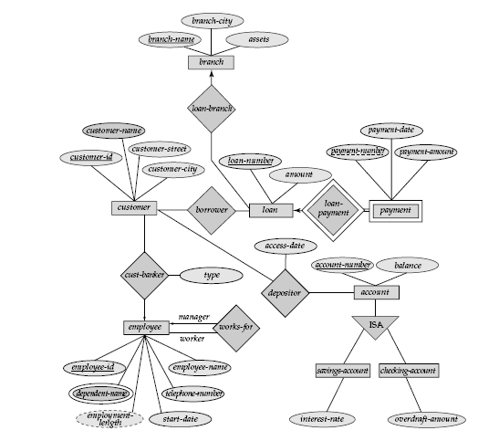

Slide 7
Schema Design

Slide 8
Schema design is the description of particular collection of data in relational database schema.
In schema design we translate ER diagrams into a collection of tables with associated constraints.
Steps to database schema design:
Map entity sets to tables
Map attributes to columns
Map relationship sets to tables
Specify primary and foreign keys
Resolve many to many relationships

Slide 9
Lets again take the Bank Enterprise example and translate Bank Enterprise ER Model into relational schema.

Slide 10
The Basics
An entity type turns into a table
Each attribute turns into a column in the table
The primary key of the entity is the primary key of the table
For composite attribute representation create one column for each component attribute. No column for the composite attributes itself.
For representation of multivalve attributes, build a new relation with two columns, one column for primary key of the entity who has multivalve attribute and another column is for multivalve attribute. Primary key for this schema is union of all attributes.
Derived attributes are ignored.

Slide 11
Now we translate our Bank Enterprise ER model entity sets and their attributes into relational schema according to above steps:

Slide 12
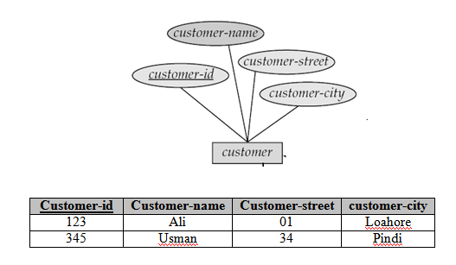
Translation of Customer Entity Set into relational schema

Slide 13
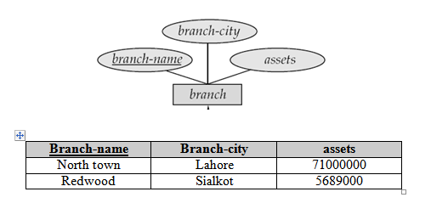
Translation of Branch entity set into Relational Schema

Slide 14
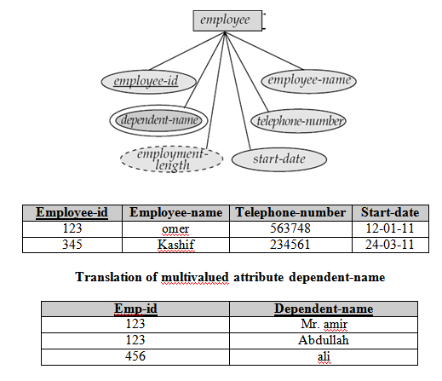
Translation of Employee Entity set into Relational model

Slide 15
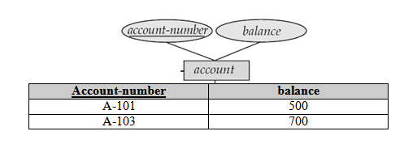
Translation of account entity set into Relational model

Slide 16

Translation of loan entity set into Relational model

Slide 17
Modeling Relationships
All relationships turn into foreign keys. Some of them also turn into an extra table.
One-to-one Relationship: To represent one-to-one relationship augment one extra column on the right side of the table of the entity set with total participation, put in there the primary key of the entity set without complete participation as per to the relationship.
One-to many/many-to-one Relationship: To represent a 1:M relationship, take the primary key of the table on the “1” side and insert it as a foreign key into the table on the “M” side. This is the most basic use of a foreign key. It may make sense to rename the foreign key to reflect its relationship to the table you are inserting it into.
Many-to-many Relationship: There is no direct representation of a M:N relationship in the relational model. You will need to turn each M:N relationship between two entities into a separate relation (table) of its own. This relation will usually have as its own primary key the combination of two foreign keys – each of these will be the primary key of one of the relations involved in this relationship.

Slide 18
Back to our Bank Enterprise database

Slide 19
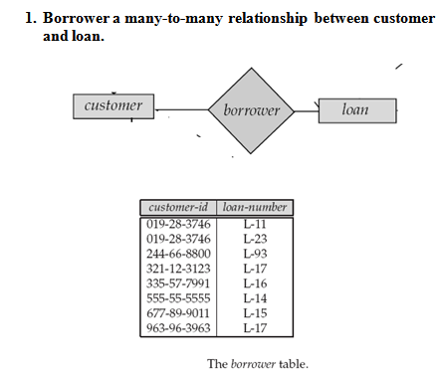
Borrower a many-to-many relationship between customer and loan.

Slide 20
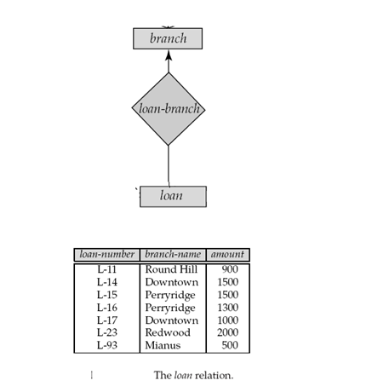
loan-branch a many-to-one relationship set

Slide 21
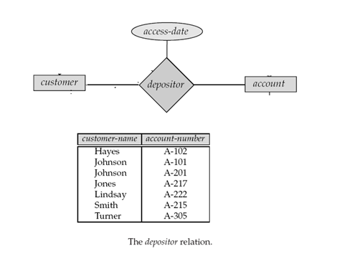
Depositor, with relationship attribute access-date, a many to many relationship between customer and account

Slide 22
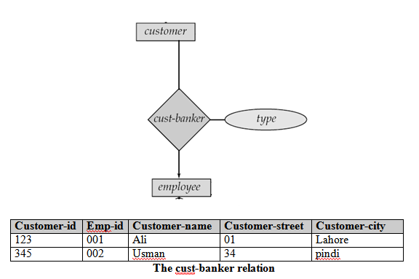
Cust-banker a many-to-one relationship with relationship attribute type between customer and bank employee.

Slide 23
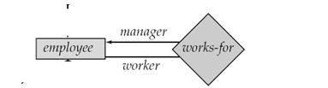
Work-for relationship between employee entities with role indicator manager and worker.
Augment one extra column on the right side of the table of the entity set with total participation, put in there the primary key of the entity set without complete participation as per to the relationship.
Employee-id | Employee-name | Telephone-number | Start-date | Manager-id
123 | omer | 563748 | 12-01-11 | 345
345 | Kashif | 234561 | 24-03-11 | null

Slide 24
Modeling super type/subtype
Generalization and specialization allow you to show that some entities in a particular entity type are also examples of more specialized subtypes, and have different attributes from other entities of the same overall entity type.
General approach: Create a table for each subclass entity set include all attributes of that subclass entity set and attributes of the super class entity set

Slide 25
Back to our Bank Enterprise database

Slide 26
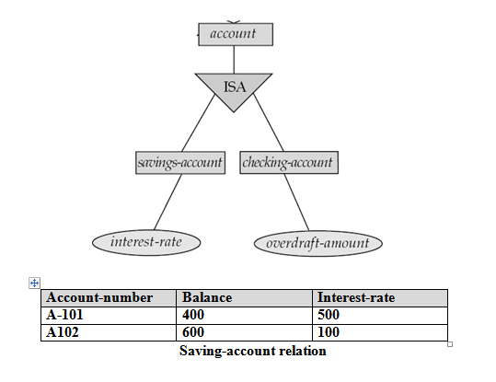
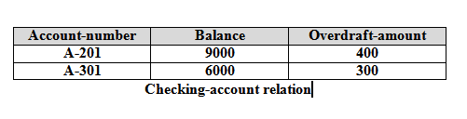
Two account entity sets—savings-account and checking-account

